Slide 1
Automation of Invoice Processing using RPA Group 4 Atin Kumar Garg Ayush Pandey Bulbul Yadav Aditya khandelwal

Slide 2
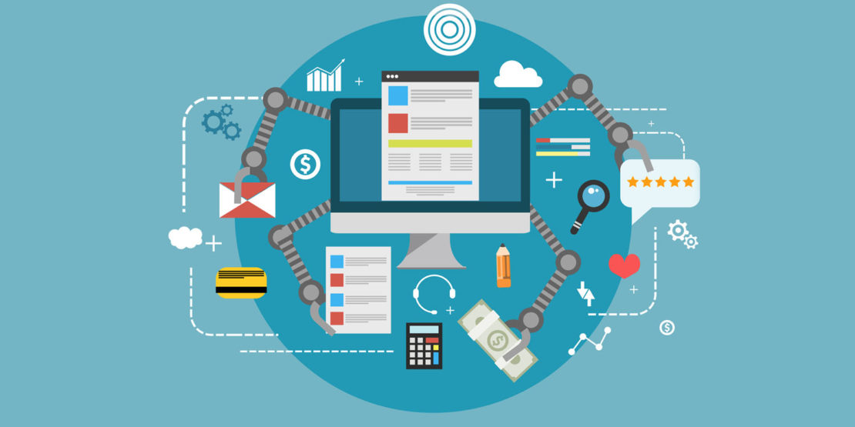
What is RPA?
Robotic process automation (or RPA) is a form of business process automation technology based on metaphorical software robots (bots) or on artificial intelligence (AI). It is sometimes referred to as software robotics (not to be confused with robot software).
RPA tools have strong technical similarities to graphical user interface testing tools. These tools also automate interactions with the GUI, and often do so by repeating a set of demonstration actions performed by a user. RPA tools differ from such systems that allow data to be handled in and between multiple applications, for instance, receiving email containing an invoice, extracting the data, and then typing that into a bookkeeping system.

Slide 3
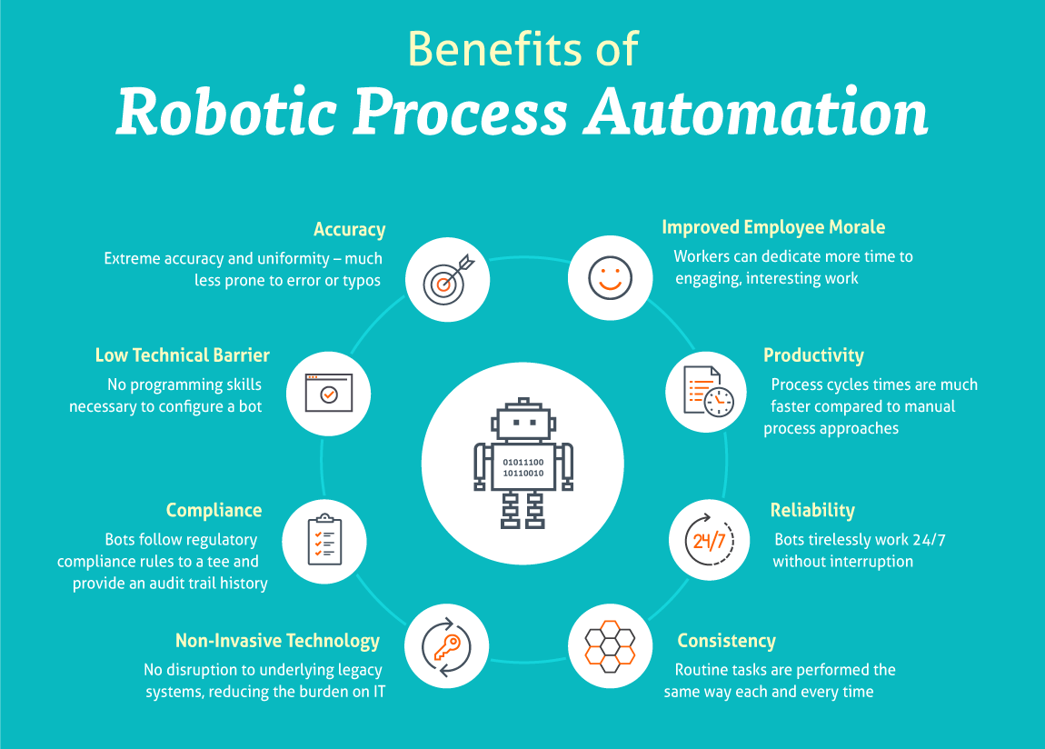

Slide 4
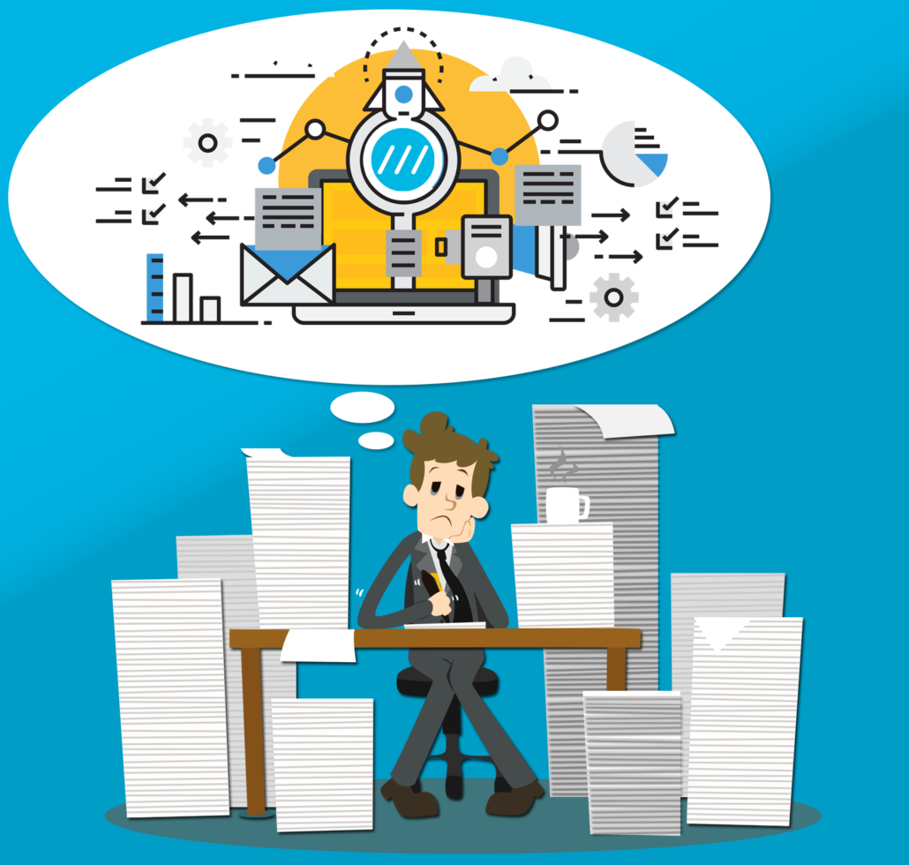
Project Overview and Challenges
The client is in one of the largest manufacturing company.
The client every day receives hundreds of invoices from vendors in PDF format.
Capturing of this data from all the invoices is a huge task and time consuming for the data entry process.
It takes between 4.1 and 16.3 days for companies to process an invoice from receipt through payment approval, according to a research report by technology services company Aberdeen Group.
The client wants to automate invoice processing to save a serious amount of time, money and also improve invoice accuracy.

Slide 5
Automation’s potential with processing
Invoices that companies receive from their suppliers sometimes, for example, arrive in multiple different formats: as a paper copy, a Microsoft Word document, a PDF email attachment, or a fax.
Moreover, a company’s finance team is responsible for manually transferring the data from these various invoice formats into the company’s database and dealing with any discrepancies.
These challenges make it difficult to handle invoices in the same way each time and, as a result, drive company employees to process invoices manually. Moreover, because the data in these invoices is typically unstructured, this manual transfer process is time-consuming and prone to errors.

Slide 6
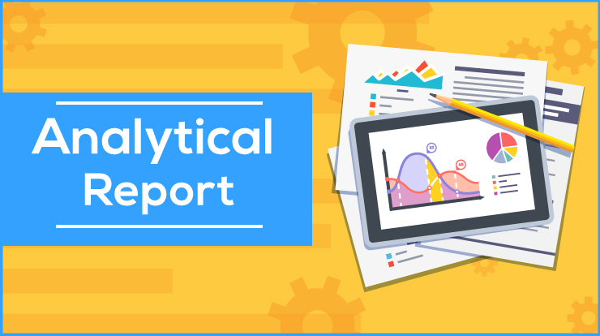
REQUIREMENT ANALYSIS REPORT
3.1 Requirement Gathering:
This is the first phase of requirement gathering of invoice processing. In this phase all the requirements related for customer will be gathered. And we have to use invoices in such a way on UIPATH Studio so that it can make easy for customer to access their bills easily.
3.2 Requirement Analysis:
We discuss an analyse pattern for invoice processing. The pattern describe an event such as creation, validation of an invoice and automate these invoices. When we gather related patterns in invoices we can easily automate it.
3.3 Requirement Specification:
Invoice processing specification is their functional and non functional requirements which shows the specification of automation of invoices on UIPATH Studio.

Slide 7
Feasibility Study
2.1 Technical Feasibility:
RPA software robots can automate data input, error reconciliation, and some of the decision-making required by finance staff when processing invoices. At the same time, automation is able to limit errors in such processes and reduce the need for manual exception handling.
2.2 Financial Feasibility:
Automated invoice processing saves time and effort by creating higher efficiency and an increase in the accuracy of captured data. By reducing the manual effort, organizations can lower the cost and increase the revenue. The benefits of invoice automation continue to enhance productivity, cash flow, and stakeholder relations.
2.3 Market Feasibility:
The scope of these processes is huge. For example, millions of invoices are processed each year and many companies process these invoices in a highly repetitive and manual way, often by hand. Because of the time investment in processing such a high volume of documents, many of the customers have looked to automation and optical character recognition (OCR).

Slide 8
Operating Environment:
Recommended browsers are Chrome, Firefox and Internet Explorer.
System Perspective:
Particulars | Client System | Server System
Operating System | Windows | Windows 10
Processor | Intel or AMD | Intel or AMD
Hard Disk | 1 GB | 1 TB
RAM | 4 GB | 8 GB

Slide 9
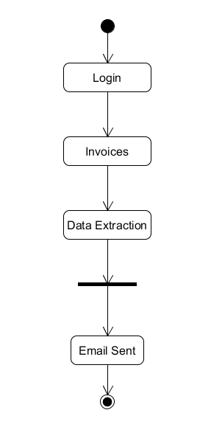
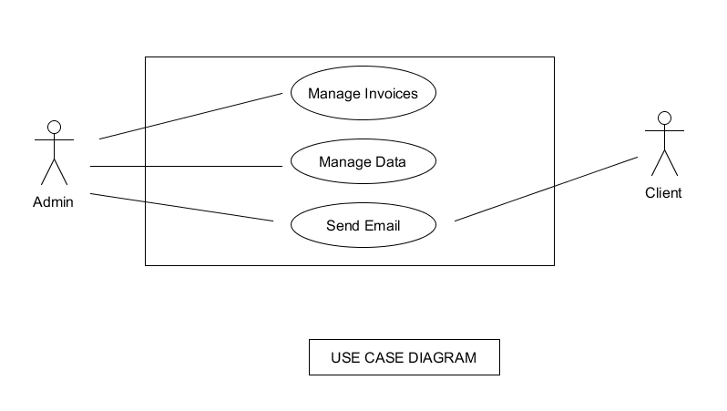
Diagrams
Activity Diagram

Slide 10
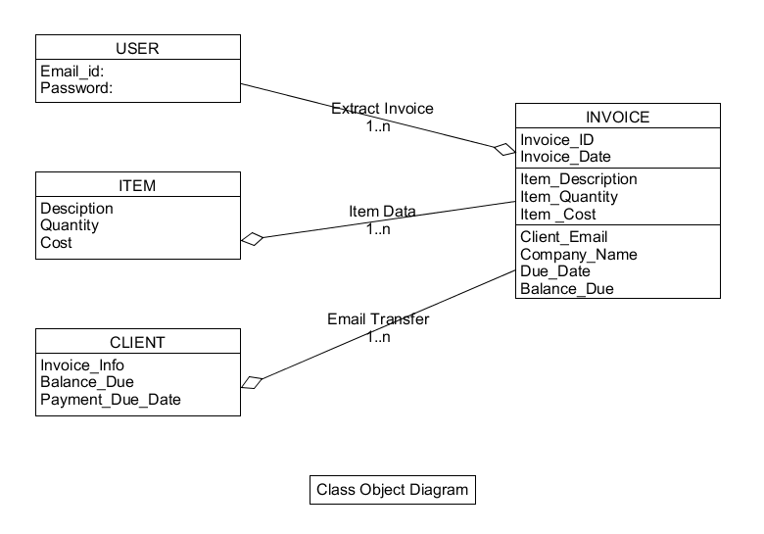
Class Object Diagram

Slide 11
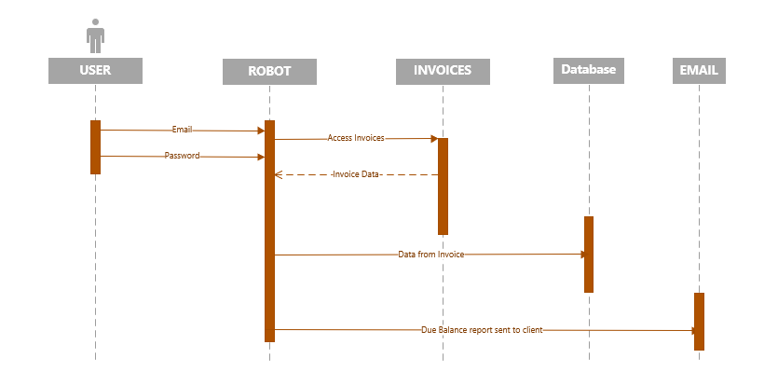
Sequence Diagram

Slide 12
Project analysis slide 3
Process of
Invoice processing
Using RPA
INVOICE
RECEIPT
INFORMATION
EXTRACTION
EMAIL
NOTIFICATION
OTHER
BACKGROUND
ACTIVITIES
TRANSFER

Slide 13
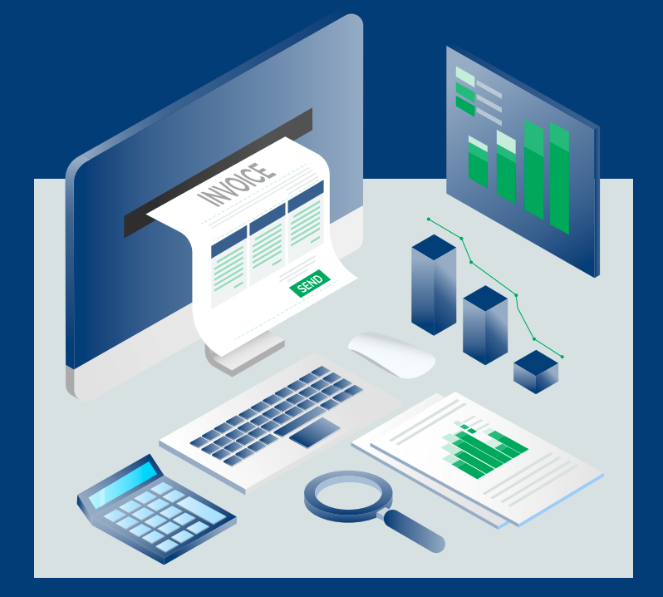
Project analysis slide 4
Invoice Processing
Invoice Receipt:
UiPath RPA software robots are able to constantly monitor a dedicated folder where invoices are saved by employees (or other software robots) in PDF format. Once robots detect the presence of an invoice in the folder, they begin to extract information from the document.
Information extraction & transfer:
Using intelligent optical character recognition (OCR) capabilities, software robots are able to read out the information that is visible on the invoice. After robots extract the key information from each invoice, they use their credentials to open the company’s database or email, if not already open. The robots then start processing the invoices one-by-one by transferring over the relevant invoice information.

Slide 14
Project analysis slide 5
Invoice Processing
Email notification:
After successfully registering each invoice, the software robots are then able to send posting notifications in the form of emails to the responsible employee or to the vendor in question. An email is also sent to the responsible party in case of an exception.
Other background activities:
During this whole process, the software robots are also running background activities such as monitoring the dedicated invoice folder or its email address, performing basic checks to see if the company’s database is open, and verifying whether vendor information (e.g. VAT number) on the invoice matches what is already in the database.

Slide 15
Project analysis slide 6
Benefits of Project
Faster data Capture.
24/7 Automation
No more lost or misfield invoice
i.e. Reducing customer complaints and increasing vendor satisfaction
Total Cost of operation is Reduced.
Zero Manual prone errors
Improved Productivity &
Improved Communication

Slide 16

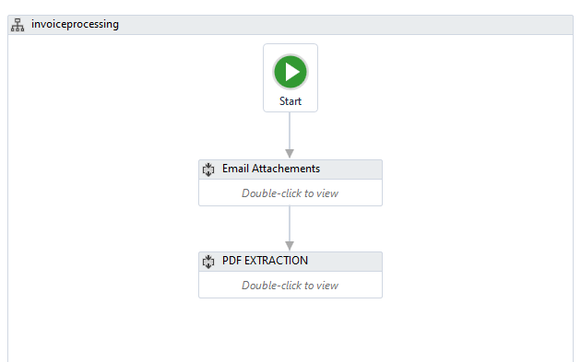
Lets Now See How our Bot works

Slide 17
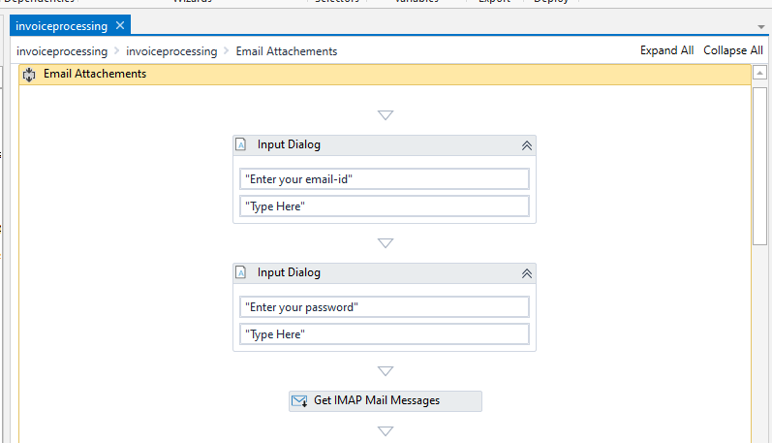
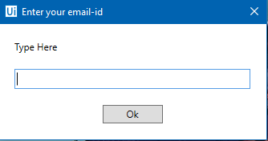

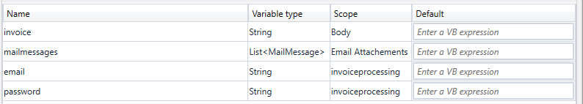
First it Signs into the users Account
Screenshot

Slide 18
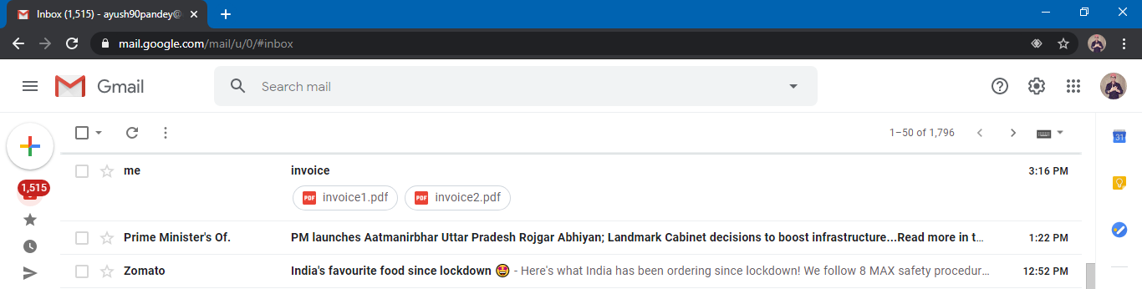
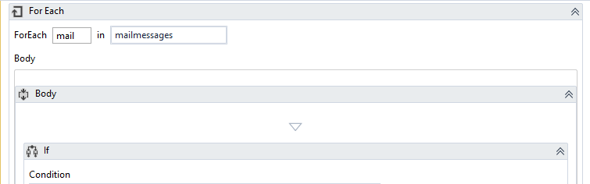
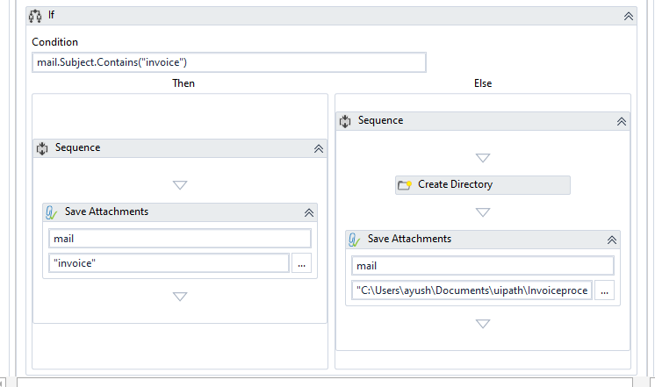
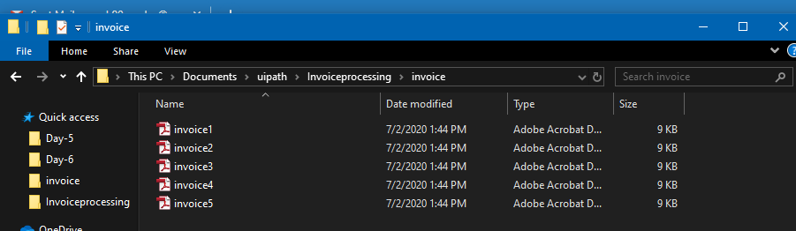
Then it reads the Invoices in the email and downloads them
Screenshot

Slide 19
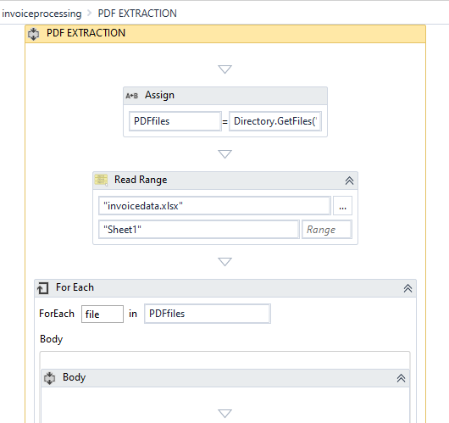
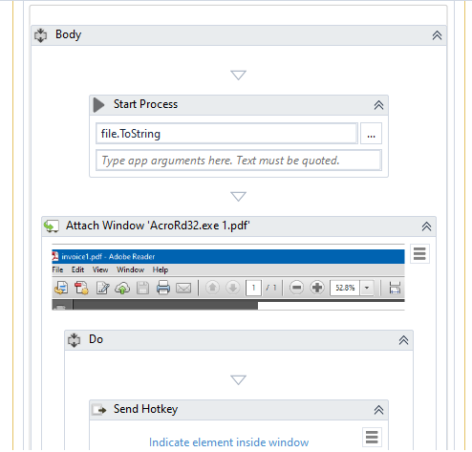
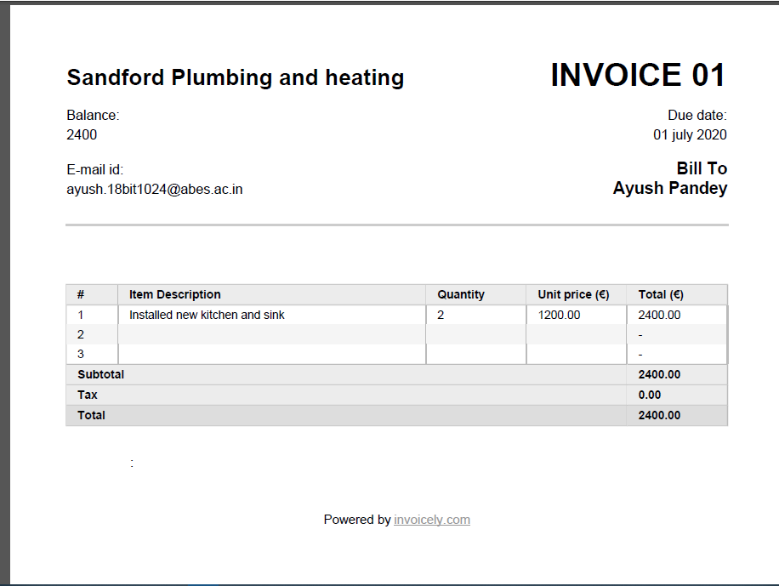
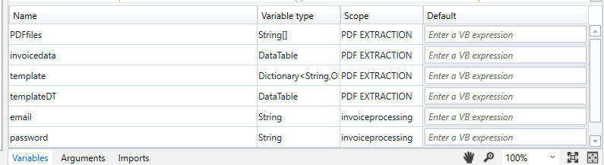
Next the data is extracted from the pdfs using anchor tag
Screenshots
Sample PDF
Variables used

Slide 20
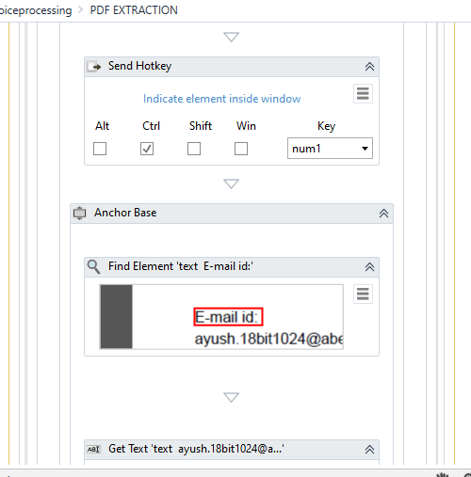
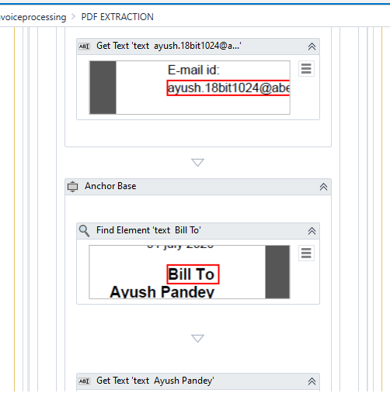
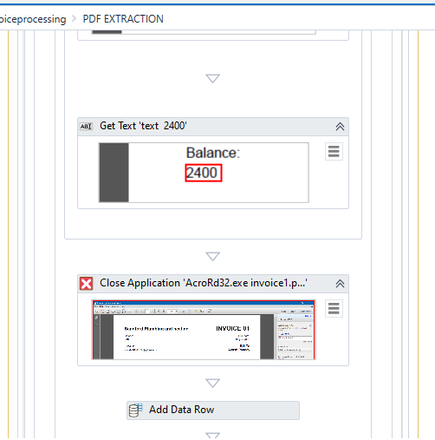
Next the data is extracted from the pdfs using anchor tag
Screenshots

Slide 21
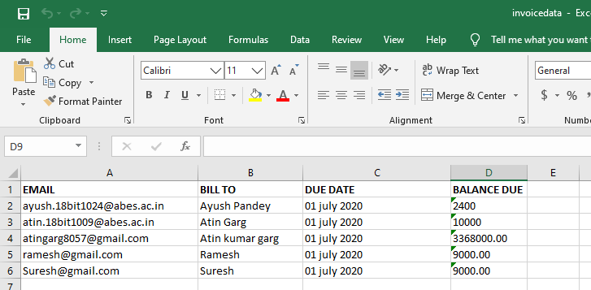
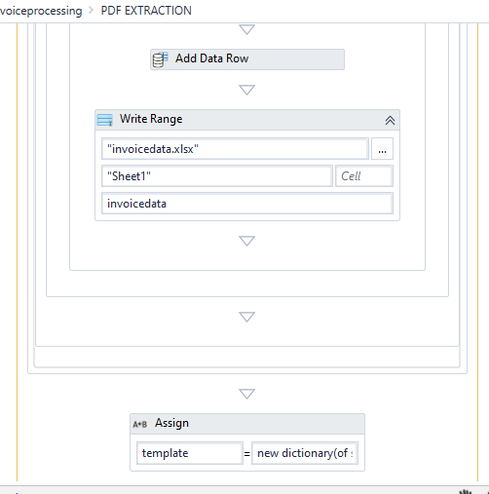
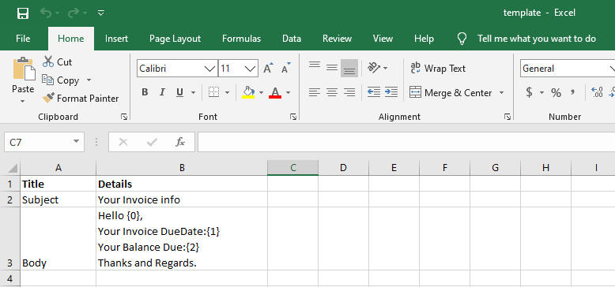
Now the data is stored in an Excel File
Screenshot

Slide 22
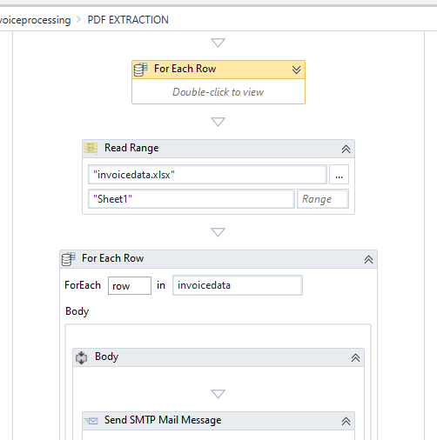
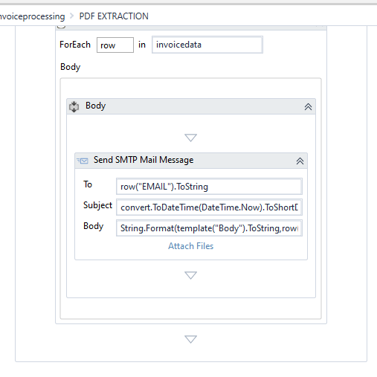
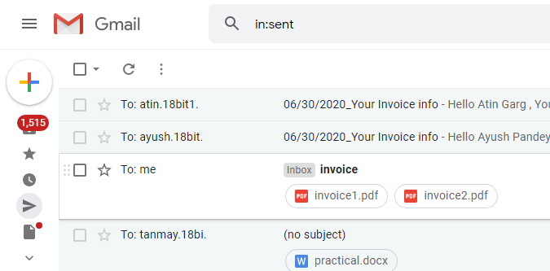
Data being filtered to be sent to the desired address
Screenshots
Email has been sent

Slide 23
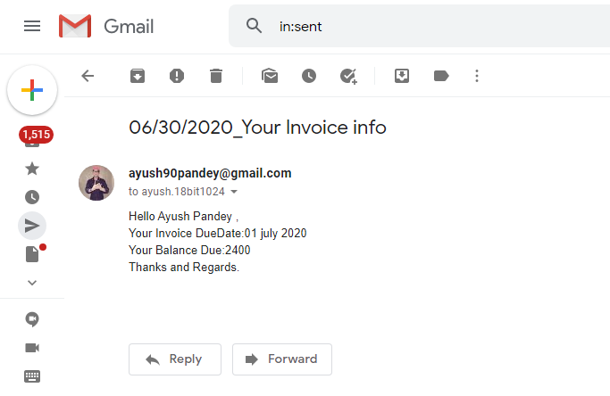

Finally the email is sent to the Respective Clients

Slide 24
CONCLUSION
Invoice management is an essential part of any business. Whether you are sending or receiving invoices, it is important that you use an efficient and integrated system to make sure that you keep everything organized. The practice of invoice management has become much easier with the advent of online systems. Keeping your invoicing procedures streamlined will allow you to keep your finances up to date, protect your credit and pay taxes easier. When you stay on top of your bills, you can spend less time organizing paper and get back to business sooner.

Slide 25
Thank You

